Slide 1
Population Genetics in a nutshell
Institute of Zoology,
Chinese Academy of Sciences, Beijing, China
Oct 2018
University of Science and Technology of China

Slide 2
A short self-introduction
USTC, School of Life Science, BS
Cornell University, Biostat, MS
UC Berkeley, Population Genetics, Ph.D
UC Berkeley, Postdoc
Beijing Institute of Genomics, Associated Investigator
Genome Institute of Singapore, Principle Investigator
National Cancer Center, Singapore, Joint faculty
Nanyang Technological University, Adjunct Assistant Prof
Institute of Zoology, Chinese Academy of Sciences, PI
1997-2002
2002-2004
2004-2008
2009.2-2009.6
2009.7-2013.8
2013.9-2018.6
2017.6-2018.6
2017.6-2018.6
2018.7-

Slide 3
Topics covered in this lecture
i) The historical context for the origin of Population Genetics
ii) Key concepts in Population Genetics
1) Hardy Weinberg Equilibrium
2) Natural selection and deterministic theory
3) Finite populations, Wright-Fisher Model, Genetic drift, effective population size
4) Mutation, measures of variability, mutation drift balance, Molecular Clock
5) Other forms of natural selection
6) Recombination, linkage disequilibrium, genome wide association studies
7) Later part of the 20th century for Population Genetics

Slide 4
General philosophy
1) The mathematical treatment of the subject can be a bit foreign to many of you. I will try to explain them as intuitively as possible.
2) the rise of Population Genetics, especially the quantitative treatment of the subject helped establish the legitimacy of evolutionary biology, a primarily historical science, in a scientific climate that favored experimental methods over historical ones.
3) This lecture is meant for giving you a glimpse of this field. If you have any questions, please feel free to stop me.

Slide 5
I) Historical context for the origin of Population Genetics

Slide 6
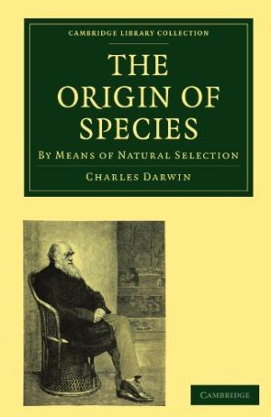
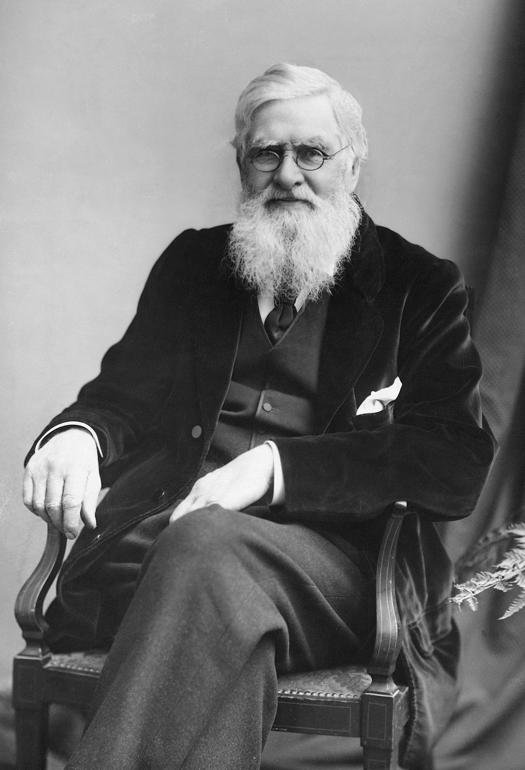
Darwin and the evolutionary theory
1) Common descend, survival of fittest.
it is an argument based on phenotypes. The survival of the fittest is operating on a complex phenotype called fitness.
2) It lacks elements related to inheritance: how phenotypes are inherited. Lacks power to explain variability within a population.
3) Understanding the relationship between genotype and phenotype is the core question of genetics, which didn’t exist in Darwin’s time.
4) Darwin, himself, is a geologist.
Alfred Wallace

Slide 7
Darwin’s perspective on inheritance
Darwinian theory is a theory without a mechanism/genetic basis. Darwin has no idea about modern genetics. Pangenesis was Darwin's attempt to provide such a mechanism of inheritance. The idea was that each part of the parent's body emitted tiny particles called gemmules, which migrated through the body to contribute to that parent's gametes.

Slide 8
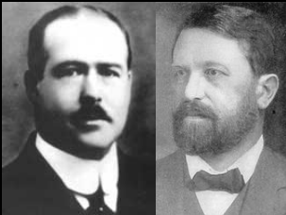
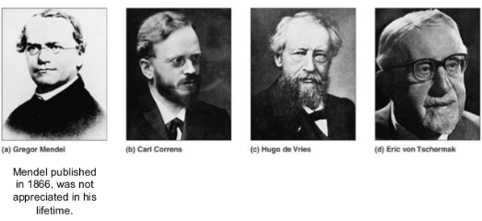
The rediscovery of Mendelian law and the birth of modern genetics
Hugo DeVries (Netherland), Carl Correns (Germany) and Erich
von Tschermak (Austria) – independently rediscovered Mendel’s
work in the same year.
1902-1903
chromosome theory of inheritance
Walter Sutton and Theodor Boveri

Slide 9
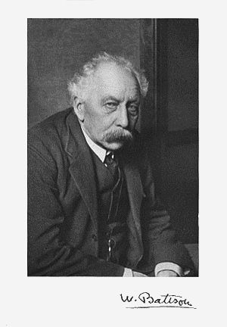
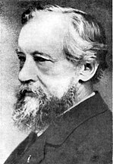
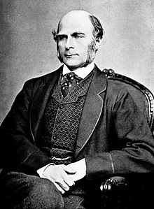
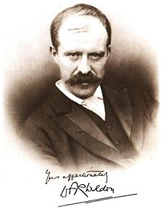
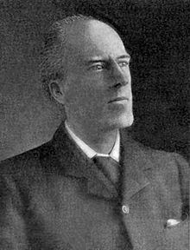
The fundamental conflict between Mendelian Genetics and Biometricians
Mendelian
Segregation is discrete
Traits are binary/discrete
Biometricians
Traits are continuous
Inheritances are “blending/averaging”
Francis Galton
(founder)
Raphael Weldon
Karl Pearson
(Protege of Galton)
William Bateson
Hugo de Vries

Slide 10
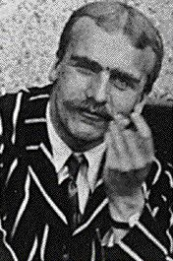
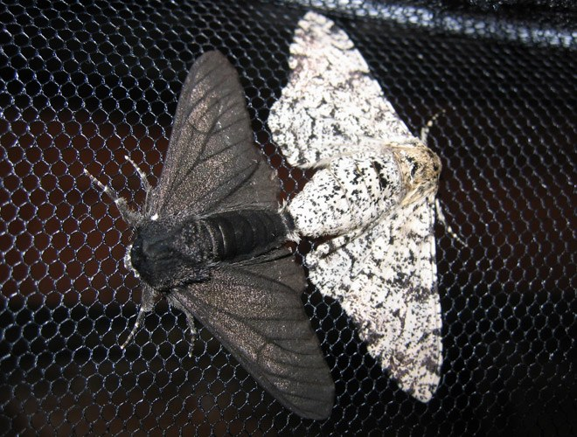
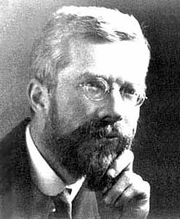
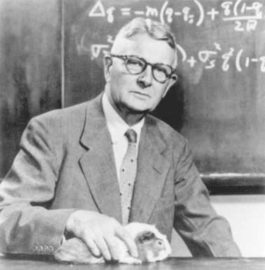
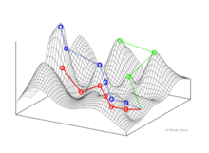
Origin of Population Genetics
JBS Haldane, 1892-1964
R.A Fisher, 1890-1962
Fisher showed that the continuous variation measured by the biometricians could be produced by the combined action of many discrete genes, and that natural selection could change gene frequencies in a population, resulting in evolution (1918-1930).
Fitness landscape
Sewall Wright, 1889-1988

Slide 11
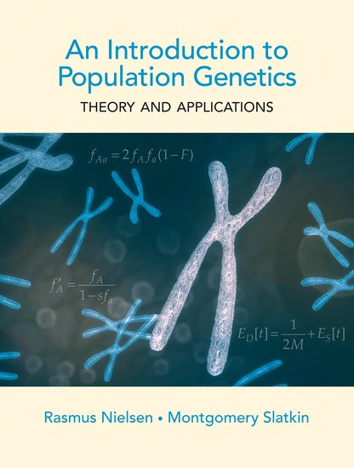
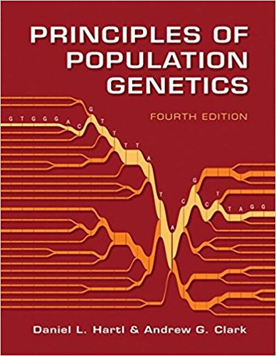
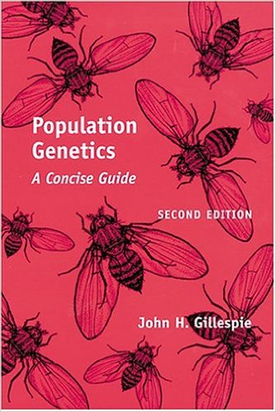
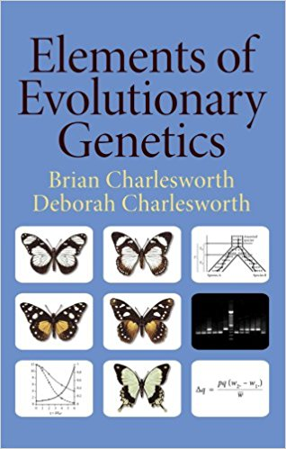
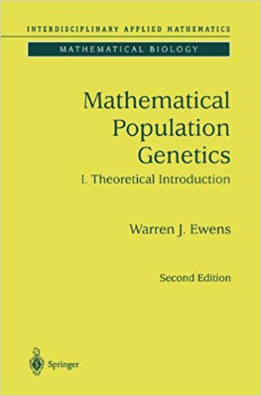
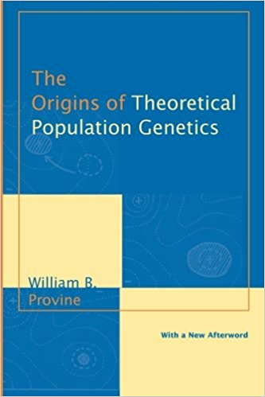
Further reading

Slide 12
II) Key concepts in Population Genetics

Slide 13
The scope of Population Genetics
Why are the patterns of variation as they are? (mathematical theory)
What are the forces that influence levels of variation?
What is the genetic basis for evolutionary change?
What data can be collected to test hypotheses about the factors that impact allele frequency?
What is the relation between genotypic variation and phenotype variation?
Evolutionary forces: Mutation, Random genetic drift, Recombination/gene conversion, Migration/Demography, Natural selection

Slide 14
2.1 Hardy Weinberg Equilibrium

Slide 15
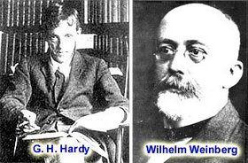
Hardy Weinberg equilibrium
The Hardy–Weinberg principle, also known as the Hardy–Weinberg equilibrium, model, theorem, or law, states that allele and genotype frequencies in a population will remain constant from generation to generation in the absence of other evolutionary influences.
English mathematician
German obstetrician-gynecologist,

Slide 16
A few concepts
1) Locus: a genomic position in the genome. It can be a single base or a genomic segment.
2) Allele: different forms of sequences at a genomic locus.
3) Genotype frequency, the proportion of genotypes in a population (sample). Given a locus with two alleles, there are three possible genotypes, AA, Aa, aa. The frequencies of these genotypes are called genotype frequencies, often denoted as f(AA), f(Aa), f(aa).
4) Allele frequency, the proportion of alleles in a population (sample). For example, the allele frequency of A (often denoted as f(A)) is f(AA) + ½ f(Aa), likewise, f(a)= f(aa) + ½*f(Aa).

Slide 17
Exercise in class I
When you take a sample of 100 humans and genotyped their hemoglobin gene. Let’s assume there are only two alleles observed and you denoted the allelic types as F (fast) and S(slow).
Let’s assume that individuals with FF is 50, FS is 40 and SS is 10.
What is the estimated genotype as well as allele frequencies?

Slide 18
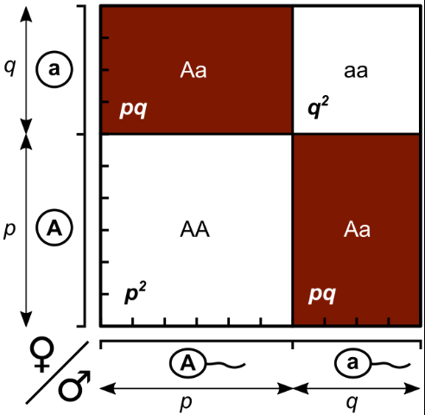
Mathematical form of HWE
When population is random mating, the expected genotype frequencies will be
f(Aa)= 2pq, f(AA)=p², f(aa)=q².
f(AA) + f(Aa) + f(aa)=1.

Slide 19
Assumptions underlying HWE
Assumptions with HWE
organisms are diploid
only sexual reproduction occurs
generations are nonoverlapping
mating is random
population size is infinitely large
allele frequencies are equal in the sexes
there is no migration, mutation or selection

Slide 20
Another interpretation of HWE
There are two degree of freedom in genotype space (i.e. three variables f(AA), f(Aa) and f(aa), but f(AA) + f(Aa) + f(aa)=1. ), but there is only one degree of freedom in allelic space (two variables, f(A) and f(a), but f(A) + f(a) =1). Hardy Weinberg equilibrium create an one-to-one map between these two spaces. In other words, HWE allows you to predict genotype frequencies from allele frequencies (vice versa).

Slide 21
Testing HWE and goodness of fit test
Under a typical null model, it will have various predictions about the values in different categories. We can then test the prediction from the model against the actual observation and calculate a test statistics (TS).
Χ² =$\sum_{i=1}^{n}{\frac{{(Oi−Ei)}^{2}}{Ei}}$
It can be proven that this TS will follow a chi-square distribution.

Slide 22
Exercise in class

Slide 23
Testing for Hardy Weinberg Equilibrium
How to test a hypothesis in general?
When you have a hypothesis in mind (in this case, HWE), you want to test whether this hypothesis is true or not. A typical conduction is that, you assume the null hypothesis is true, you make various predictions about the system, then you test your observed values against the expected and decide whether the two match each other or not.
There are many statistical approaches testing for the matching of the observed and expected values. Today, we will use one of these approaches.

Slide 24
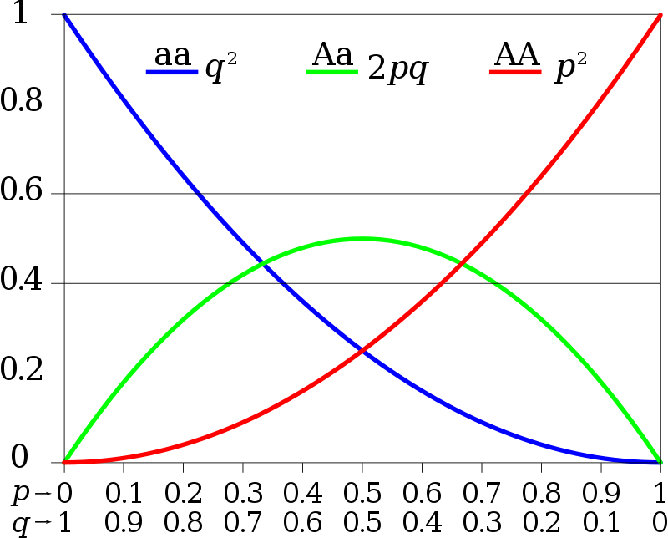
Remind ourselves: HWE
When population is random mating, the expected genotype frequencies will be
f(Aa)= 2pq, f(AA)=p², f(aa)=q².
f(AA) + f(Aa) + f(aa)=1.

Slide 25
Example
You sampled a population with 30 AA, 45 Aa and 25aa. Is HWE true for this sample?
Step 1) estimate the allele frequency of the sample;
There are 100 individuals, the frequency of A= f(AA) + ½* f(Aa),
The frequency of AA is 0.3, f(Aa)=0.45, So, the frequency of A is 0.525.
Step 2) predict the expected genotype frequency from allele frequencies
based on HWE. Since f(A)=0.525, f(a)=0.475. The predicted genotype frequencies are: 28, 50 and 22 respectively.

Slide 26
Example continued
Under a typical null model, it will have various predictions about the values in different categories. We can then test the prediction from the model against the actual observation and calculate a test statistics (TS). Χ² =$\sum_{i=1}^{n}{\frac{{(Oi−Ei)}^{2}}{Ei}}$
It can be proven that this TS will follow a chi-square distribution.
Category | Observed | Expected | Difference
AA | 30 | 28 | 0.14
Aa | 45 | 50 | 0.5
aa | 25 | 22 | 0.41
SUM |  |  | 1.05
The 5% cutoff for the Chi-Square test is 3.84. The calculated value is smaller than 3.84. So, there
is not enough of evidence to reject HWE in this case.

Slide 27
Side note
Chi-square distribution has a parameter called degree of freedom. In this case, we use chisq(df=1).
The number of degrees is calculated as # of categories – estimated parameters -1

Slide 28
Key points
1) how to calculate allele and genotype frequencies in a population (sample).
2) how to predict genotype frequencies given allele frequencies assuming HWE

Slide 29
2.2 Natural selection and deterministic theory

Slide 30
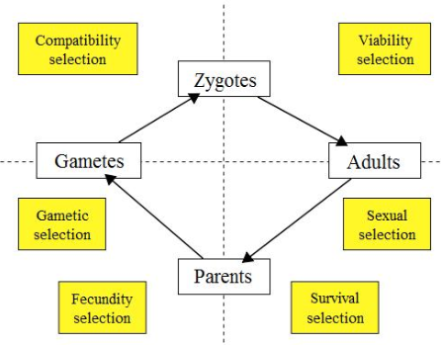
A few concepts
1) Fitness, describes individual reproductive success and is equal to the average contribution to the gene pool of the next generation that is made by individuals of the specified genotype or phenotype.
2) Viability selection, the selection of
individual organisms who can survive until
they are able to reproduce.
3) Absolute/relative fitness,
Absolute: The # of offsprings (or reproductive success) of a genotype.
Relative: Rescale fitness against one genotype. For example, we sometimes rescale the fitness against fitness values from the largest (smallest) genotypes.

Slide 31
Deterministic theory (viability selection)
When population size is infinitely large, how population evolve from generation to generation (change in allele/genotype frequencies).
AA Aa aa
Fitness 1+s 1+hs 1
Freq before selection p² 2pq q²
Population_mean_fitness=w^bar
=p²*(1+s) +2pq(1+hs) +q²
Freq after selection will be:
f(AA)’=p²*(1+s)/w^bar, f(Aa)’=2pq*(1+hs)/w^bar and
f(aa)’= q²*1/w^bar

Slide 32
Exercise in class 2
Given h=1/2, s=0.01, starting from A being 0.5, what’s the frequency of A after one generations?

Slide 33
Example given in class
Given h=1/2, s=0.01, starting from A being 0.5, what’s the frequency of A after one generations?
 | AA | Aa | aa
Frequency at zygotic stage | p² | 2pq | q²
 | 0.25 | 0.5 | 0.25
Fitness value | (1+s)=1.01 | (1+hs)=1.005 | 1
Post zygotic after selection | p²*(1+s) | 2pq*(1+hs) | q²*1
 | 0.2525 | 0.5025 | 0.25
Normalizing factor W_bar=p²*(1+s) + 2pq*(1+hs) + q²*1= 1.005
Genotype freq post selection | 0.2512 | 0.5 | 0.2488
Allele freq | f(A)=0.5012, f(a)=0.4988

Slide 34
A computer exercise
1) python code for simulating allele frequencies
2) a R code to plot the trajectories

Slide 35
Observations from the deterministic theory
1) The alleles of fitness advantage will increase in frequency, until hitting equilibrium (often times fixation).
2) the mean fitness of the population will increase due to the higher prevalence of the “better” alleles in each generation. This constant increase in mean fitness is called Fisher’s fundamental theorem of natural selection.
3) Fisher predicted not only mean fitness will increase, but also predicted the amount of increase in each generation (not covered here).

Slide 36
Key concepts
1) understand the operational details how to calculate allele and genotype frequencies using deterministic theory.

Slide 37
2.3 Finite populations, Wright-Fisher Model, Genetic drift, effective population size

Slide 38
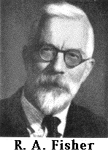
R.A Fisher and Sewall Wright
Historical background: Fisher’s fundamental theorem of natural selection.
The increase in mean fitness equals to the additive components of genetic variance in fitness.
Fisher tends to think in terms of large populations and changes in allelic frequencies are deterministic.
Sewall Wright

Slide 39
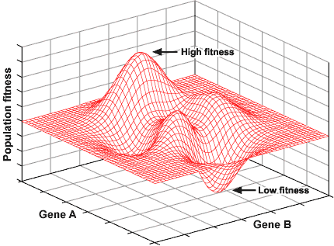
Wright’s view on small populations
How to move from one adaptive peak to another.
Genetic drift (together with gene flow/migration) allows the population to move from one peak to another through the valleys.
Fitness landscape
Sewall Wright

Slide 40
How populations evolve: The Wright-Fisher model
For formulation:
Generation 1
Generation 2
Generation 3
Generation 4
Generation 5
Need a mathematical framework to describe the change in allele frequency
from generation to generation.
Mechanical end of Wright-Fisher Model: There are N individuals, 2N genes, we sample with replacement from previous generation 2N new genes, to form the new generation. This is the Wright-Fisher model.
It is a binomial/multinomial distribution conditioning on allele frequency from the previous generation.

Slide 41
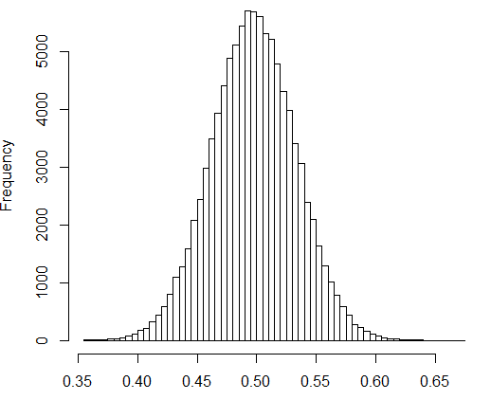
A simple exercise
A population of size 100, allele frequency of the current generation is 0.5. If the population follows the Wright-Fisher model, what’s the allele frequency of the population in the next generation?
The frequency of the allele in the next generation is a random variable (i.e. r.v. not a fixed value).
The mean of the r.v is:

Slide 42
Predictions and properties of the Wright-Fisher model
Genetic drift: the random fluctuation of allele frequencies across generations. Drift measures variance in allele frequencies across generations.
The effect of drift is larger in small populations, much smaller in bigger populations.
The expectation of allele frequencies from generation to generation is constant.
The long term fate of alleles, is either fixation or extinction. In other words, drift will reduce the level of genetic variability.
Illustration of random genetic drift

Slide 43
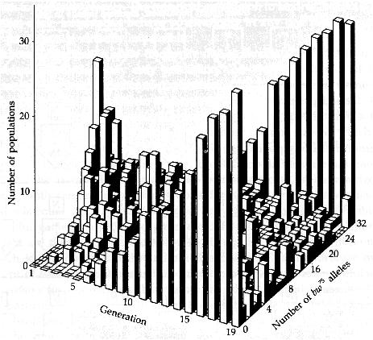
A few properties of the Wright-Fisher Model
The long term fate of an allele is: lost or fixation.
The probability of fixation of an allele of frequency p is: ?
Given an allele, which just entered the population, its frequency will be 1/2N, the time to fixation is: 4N generations.

Slide 44
Effective population size and the Wright Fisher model
Census population size (N) : the actual number of individuals in a population/species.
Effective population size (Ne): it is a concept mapping between actual population and “Wright-Fisher population” (like an ideal gas).
Real Population
Size of N
Wright-Fisher population
Size of Ne
Properties of the
population
(e.g. variance in changes
in allele frequency. )

Slide 45
Key Concepts
1) Understand Wright-Fisher model (including fixation probability).
2) Understand that genetic drift will purge genetic variability.

